Slide 1


Slide 2

THE PROBLEM: SMALL BUSINESSES ARE LOSING
THE CONTENT GAME
HAILU TESFAYE
WHY CONTENT CREATION IS BROKEN FOR SMEs
60%
of small business owners identify content creation as their top marketing challenge
No time, no expertise, wrong tools. Generic AI requires prompt engineering skills most owners don't have.
NIT3003 | Victoria University | 2026
2

Slide 3

HAILU TESFAYE
OUR SOLUTION: AI-POWERED CONTENT FOR EVERY BUSINESS
A cloud-based SaaS platform that generates professional marketing content using generative AI — no technical expertise required.
Social Media Captions
Blog Outlines
Email Newsletters
On-brand, on-length, platform-specific with calls to action
Structured sections with intros, conclusions, and SEO focus
Subject lines, body copy, and CTA buttons ready to send
Multi-tenant SaaS — secure isolation per business, cloud-deployed on Vercel
NIT3003 | Victoria University | 2026
3

Slide 4
HAILU TESFAYE
PROJECT SCOPE: WHAT WE'RE BUILDING —
AND WHAT WE'RE NOT
IN SCOPE
OUT OF SCOPE
Multi-tenant auth
Business profile setup
Campaign automation
CRM integration
Content generation (3 types)
Built-in content editor
Image / video generation
Advanced analytics
Content storage and dashboard
Tone and keyword analysis
Commercial deployment
Cloud deployment (SaaS)
Quality evaluation engine
NIT3003 | Victoria University | 2026
4

Slide 5

FUNCTIONAL REQUIREMENTS
SEMIR ABDU
What the system must do
AUTHENTICATION
PROFILE MANAGEMENT
Email/password login with hashed storage (bcrypt). Session management via Supabase Auth.
Business profile: name, industry, target audience, brand tone. Validated inputs.
CONTENT GENERATION
QUALITY AND RATING
Type selector (social, blog, email). AI generation with progress indicator.
1-5 star rating on every draft. Automated 5-metric quality scoring displayed.
DASHBOARD
EXPORT
Content history with search, filter, delete. Usage metrics at a glance.
Copy to clipboard. Rich-text editor for review and editing before publishing.
NIT3003 | Victoria University | 2026
5

Slide 6
DATABASE DESIGN
SEMIR ABDU
Three-table relational schema
Users
Business_Profile
Generated_Content
id (PK)
id (PK)
id (PK)
user_id (FK)
email
user_id (FK)
content_type
password_hash
business_name
quality_score
created_at
industry
rating
target_audience
analysis_json
brand_tone
created_at
description
quality_score
8
status
Foreign keys enforce data isolation per user (multi-tenancy via row-level security)
NIT3003 | Victoria University | 2026
edited_at

Slide 7



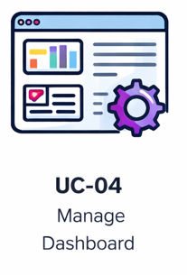
USE CASES
SEMIR ABDU
Core user interactions
UC-01
UC-02
UC-03
UC-04
Register and Create Profile
Generate Content
Review, Rate, Export
Manage Dashboard
Select type, enter topic. System calls AI and evaluates quality.
Edit in editor, rate 1-5 stars, copy to clipboard for publishing.
View history, filter by type, see quality scores, delete drafts.
Sign up, complete business profile with industry, tone, audience data.
NIT3003 | Victoria University | 2026
7

Slide 8

PROJECT TIMELINE
Semir Abdu
Phased delivery
NIT3003
Build
Integrate
NIT3004
Proposal and Design
Backend + Frontend
AI Pipeline
Testing and Delivery
Quality Engine
COMPLETE
Auth, API, UI
80% TARGET
Goal: 80% implementation complete before NIT3004 delivery.
NIT3003 | Victoria University | 2026
14

Slide 9
DANIEL PALAZZOLO
SYSTEM ARCHITECTURE: FIVE COMPONENT DESIGN
User
Frontend
Backend
Database
AI Engine
>
>
>
>
Business Owner
Next.js
Vercel Routes
Supabase
OpenAI GPT-4
Authentication Flow
Content Generation Flow
Review and Publish Flow
NIT3003 | Victoria University | 2026
9

Slide 10
TECHNOLOGY STACK
DANIEL PALAZZOLO
One repo. One language. Zero servers.
FRONTEND + BACKEND
DATABASE + AUTH
AI ENGINE
DEPLOYMENT
Next.js
Supabase
OpenAI API
Vercel
React UI and serverless API routes in a single project. SSR for performance.
Managed PostgreSQL with built-in auth and row-level security for multi-tenancy.
GPT-4 primary, GPT-3.5 fallback. Pay-per-use. Well-documented SDK.
Serverless, git-push CI/CD. Auto-scaling, zero infrastructure.
TypeScript everywhere — single language across frontend, API routes, and database queries
NIT3003 | Victoria University | 2026
10

Slide 11
CORE ALGORITHM: 7-PHASE CONTENT
GENERATION PIPELINE
DANIEL PALAZZOLO
Not a pass-through to ChatGPT — a structured engineering pipeline with fault tolerance and quality gates.
PHASE 1
>
PHASE 2
>
PHASE 3
>
PHASE 4
>
PHASE 5
>
PHASE 6
>
PHASE 7
Auth & Rate Limit
Profile Retrieval
Prompt Assembly
API Call + Retry
Quality Eval
Auto-Regen
Store & Return
PROMPT ENGINEERING
FAULT TOLERANCE
QUALITY GATE
System instruction sets role, tone, audience. User prompt combines topic, keywords, and content-type constraints.
2 retries on GPT-4 timeout, then automatic fallback to GPT-3.5 Turbo. User input preserved on failure.
If quality score < 0.6, system auto-regenerates with adjusted prompt citing specific deficiencies.
NIT3003 | Victoria University | 2026
11

Slide 12
DANIEL PALAZZOLO
QUALITY EVALUATION ENGINE
5 weighted metrics
Every draft is scored before the user sees it. The heaviest weight goes to historical user ratings.
User Satisfaction
35%
Tone Alignment
20%
QUALITY THRESHOLD
0.60
Keyword Integration
20%
Structural Compliance
15%
Below this triggers auto-regeneration
Readability
10%
Feedback loop: ratings stored in analysis_json shape future quality scoring — system learns from user judgement
NIT3003 | Victoria University | 2026
12

Slide 13
NON-FUNCTIONAL REQUIREMENTS
JAMAL HUSSEIN
Performance, security, and usability targets
PERFORMANCE
SECURITY
SCALABILITY
USABILITY
Dashboard: < 2s
Short-form AI:
< 15s
Long-form AI:
< 45s
API p95:
< 250ms
TLS 1.3 encryption
bcrypt / Argon2id hashing
API keys in env vars only
Parameterized SQL queries
50 concurrent users 100+ req/min with queueing 99.9% uptime target
Core task in 5 clicks
WCAG 2.1 Level AA
Responsive: desktop + tablet
Non-technical language
NIT3003 | Victoria University | 2026
6

Slide 14
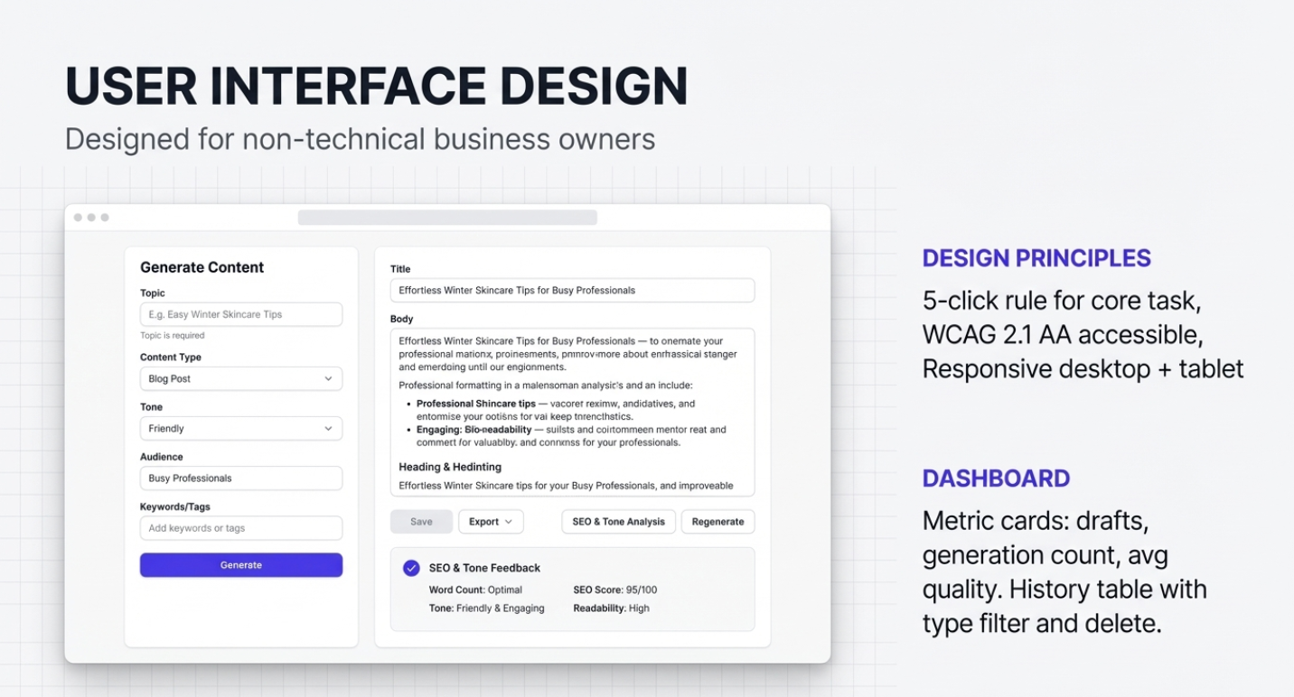
JAMAL HUSSEIN
USER INTERFACE DESIGN
JAMAL HUSSEIN
Designed for non-technical business owners
CONTENT GENERATION VIEW
DESIGN PRINCIPLES
Sidebar | Two-Column Layout
5-click rule for core task
LEFT: [ Type v ] [ Topic ] [ Keywords ]
WCAG 2.1 AA accessible
[ > Generate Content ]
Responsive desktop + tablet
RIGHT: | AI-generated content |
| in rich-text editor |
Quality: ######### 0.78
DASHBOARD
Metric cards: drafts, generation count, avg quality. History table with type filter and delete.
Rating: *****
[ Copy ] [ Discard ]
NIT3003 | Victoria University | 2026
13

Slide 15
JAMAL HUSSEIN
RISK MANAGEMENT
Key risks and mitigations
RISK
LEVEL
MITIGATION
API service downtime
HIGH
Retry logic + GPT-3.5 fallback + graceful errors
Scope creep
HIGH
Strict in/out scope boundary documented
Data security breach
HIGH
TLS 1.3, RLS, hashed passwords, env-var secrets
Poor LLM output
MED
5-metric evaluation + auto-regeneration
NIT3003 | Victoria University | 2026
14

Slide 16
HAILU TESFAYE
MORE THAN A CHATGPT
WRAPPER
> Structured prompt engineering combining business context, type rules, and brand voice
> 5-metric quality evaluation that scores content before the user sees it
> User feedback loop where star ratings actively shape future quality
> Fault-tolerant architecture with retry logic, model fallback, graceful degradation
Questions?
Hailu | Daniel | Semir | Jamal
NIT3003 | Victoria University | 2026
15

